Slide 1
AAQC - Autonomous air quality control
Group 16 - Tobias Haller, Jonas Hofer, and Christian Müller

Slide 2


Slide 3
Sensors
Humidity
Temperature
CO2
Particulate

Slide 4
Actuators
Air-conditioning
Heater
Ventilation
Air-purifier

Slide 5
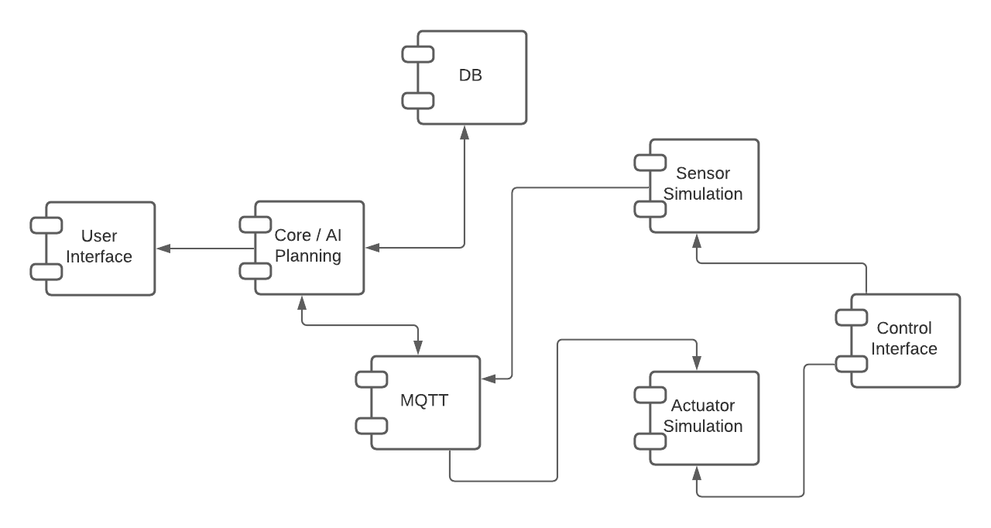
Architecture

Slide 6
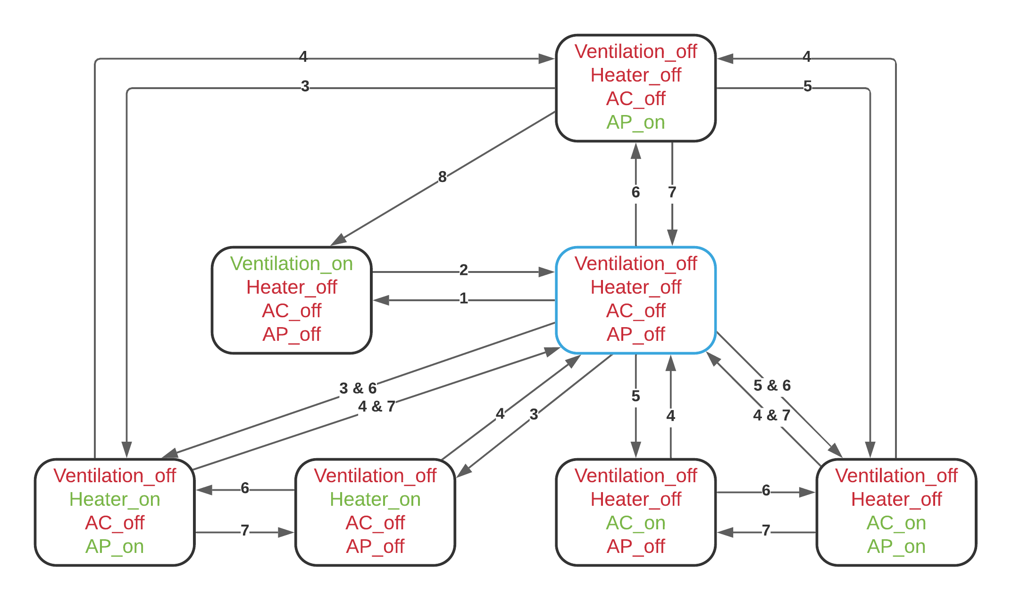
State changes

Slide 7
AAQC - Live Demo

Slide 8
